Slide 1
TASK 3: REQUIREMENT ANALYSIS
PRESENTED BY:
ETHE ENAME CLAUDE VIRGIL (SENG22SE015)
ETIKWE RAMPSON (SENG22TE004)
AGBOR AYAMBA (SENG22TE002)
COURSE TITLE: INTERNET PROGRAMING
AND
MOBILE PROGRAMMING
COURSE INSTRUCTOR:
DR. VALERY NKEMINI

Slide 2
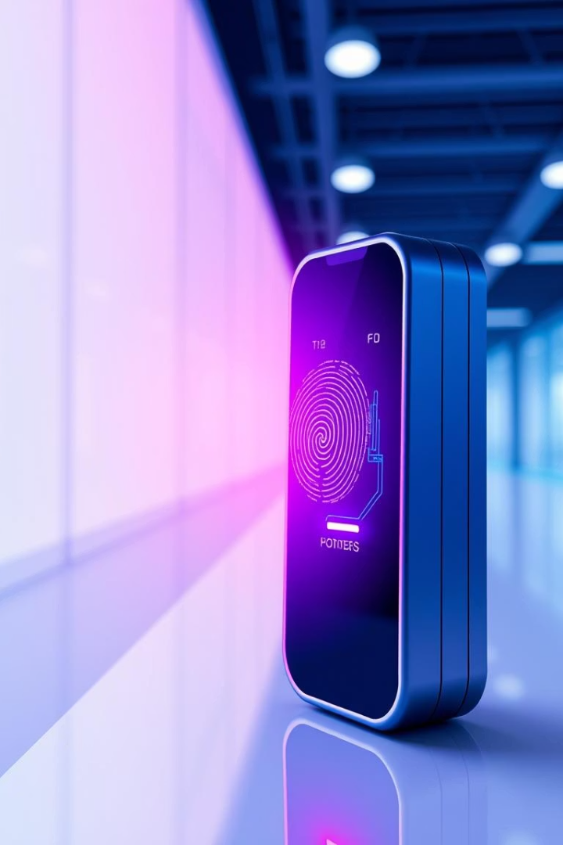
Requirement Analysis for Bio-metric Student Attendance System
The requirement analysis phase is critical for the success of the bio-metric student attendance system project. It involves a thorough examination of the gathered requirements to ensure they are complete, clear, and technically feasible. This phase establishes a foundation for the project by identifying dependencies and addressing potential pitfalls early.
A well-conducted requirement analysis leads to a precise Software Requirements Specification (SRS) document and aligns stakeholder expectations, enabling smoother project execution and delivery.

Slide 3

Reviewing and Analyzing Requirements
Completeness
Verify that all necessary requirements are captured, covering all system functional and operational scenarios.
Clarity
Ensure requirements are clearly stated, unambiguous, and easily understood by all project participants.
Technical Feasibility
Assess whether current technology supports the implementation of the specified features.
Dependency Relationships
Identify interdependent requirements that influence design and implementation priorities.

Slide 4

Identifying Inconsistencies, Ambiguities, and Missing Information
Inconsistencies
Ambiguities
Missing Information
Detect conflicts or contradictions between requirements that may impact system behavior.
Highlight vague or unclear statements that can lead to misinterpretation during development.
Spot any gaps or omitted details critical for comprehensive system definition and design.

Slide 5
Prioritizing Requirements
Importance
Feasibility
Rank requirements based on their impact on system functionality and user satisfaction.
Evaluate the technical and resource feasibility to determine realistic implementation timelines and effort.

Slide 6
Classifying Requirements: Functional vs Non-Functional
Functional Requirements
Non-Functional Requirements
User authentication via biometric verification
System response time under 2 seconds
Real-time attendance recording
Data privacy and encryption compliance
Generation of attendance reports
System uptime of 99.9%

Slide 7




Developing the Software Requirement Specification (SRS)
Document Structure
Create sections detailing system overview, functionalities, constraints, and interfaces.
Clarity and Precision
Write clear, testable, and unambiguous requirements for developers and testers.
Version Control
Manage updates and track changes to maintain SRS accuracy throughout the project lifecycle.

Slide 8
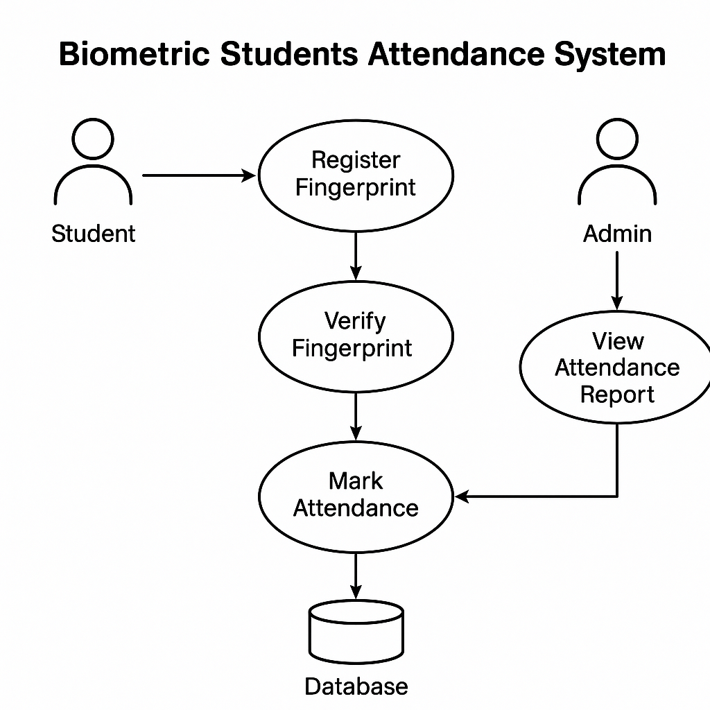

Slide 9
Validating Requirements with Stakeholders
Review Sessions
Feedback Incorporation
Final Sign-off
Conduct iterative meetings with users, sponsors, and technical teams to verify requirement accuracy.
Collect and integrate stakeholder input to resolve misunderstandings and improve completeness.
Obtain formal approval of requirements to establish shared commitment before development begins.

Slide 10
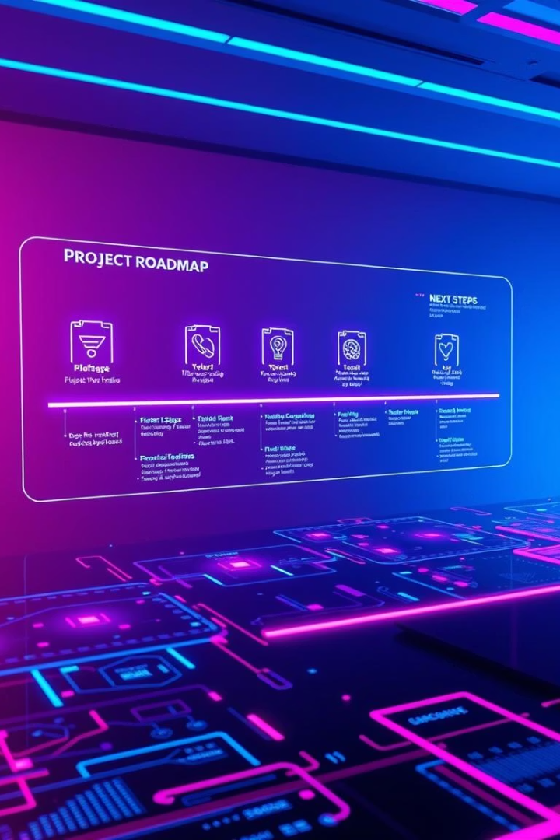
Key Takeaways and Next Steps
Comprehensive Analysis
Stakeholder Engagement
Thorough review ensures well-defined, clear, and feasible requirements.
Active validation facilitates shared understanding and agreement.
Next Steps
Proceed to detailed design phase and prepare development plans based on the SRS.

